Slide 1
Code Insighter
Group-12
Project Live Link: http://172.17.0.73:8073/
Repository Link: https://git.cs.dal.ca/courses/2023-fall/csci-5308/Group12
Dev Team: Client team:
Nisarg Khacharia (B00959791) Kunal Makwana(B00961220)
Pooja Chauhan (B00971297) Namrata Bhaumik (B00957053)
Pratik Sakaria (B00954261) Shahroz Ahmad (B00950011)
Sameer Amesara (B00961209) Tijilkumar Parmar (B00953583)
Zeel Ravalani (B00917373)

Slide 2
Project Summary
This project is centred around LLM-based insight mining for software engineers and is implemented as a website. It is a Java Spring Boot application engineered to provide comprehensive insights into software development practices. Users log in by signing up with their GitHub account, which grants them access to a dashboard displaying all their repositories. Through a user-friendly interface, it delivers real-time feedback on potential pitfalls, fosters better collaboration among team members, and empowers developers to make informed decisions, thereby significantly improving the overall quality and efficiency of software development processes.
The project utilizes preprocessed data from GitHub repositories to feed a language model (LLM), which then provides responses, essentially offering opinions on the insights in question. By leveraging its suite of functionalities, it actively identifies and addresses common coding errors, facilitates collaborative analysis, enhances code quality, customizes code linting, ensures compatibility of dependencies, and detects bugs within the application flow. Visual cues are also provided as charts to enhance the user experience.

Slide 3
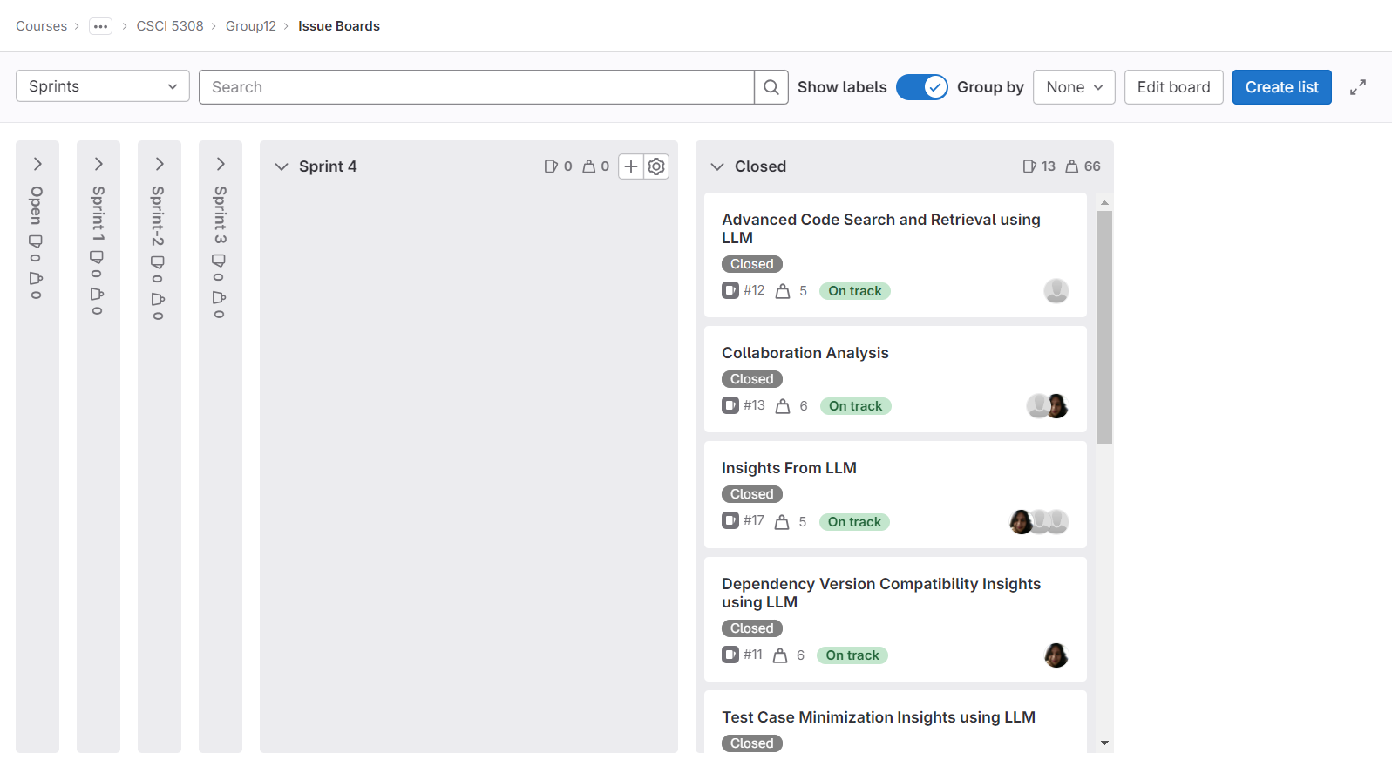
GitLab Dashboard Screenshots

Slide 4
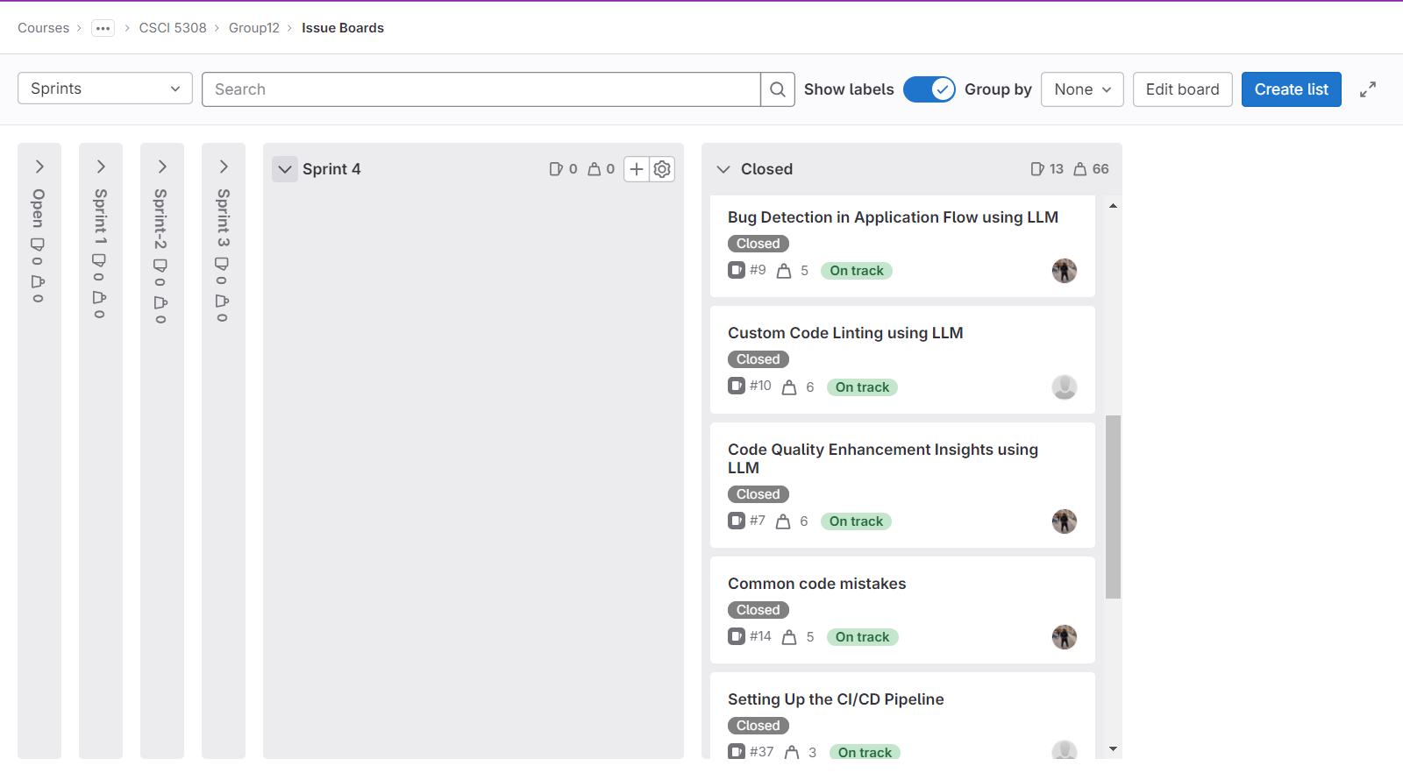
GitLab Dashboard Screenshots

Slide 5
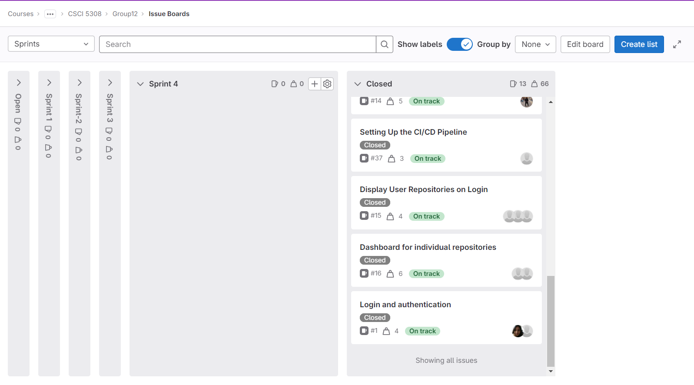
GitLab Dashboard Screenshots

Slide 6
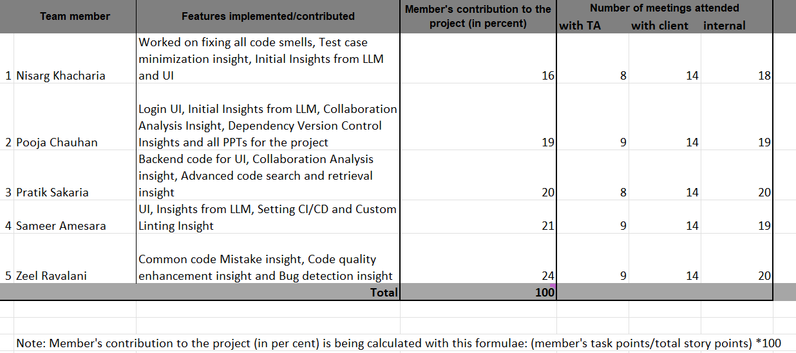
Total Story Points
.

Slide 7
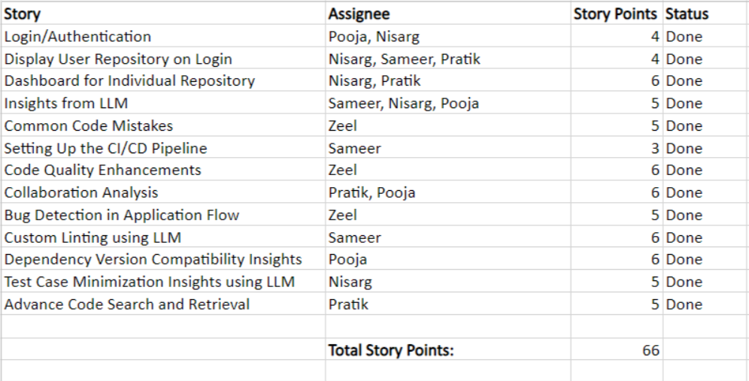
Total Story Points
.

Slide 8
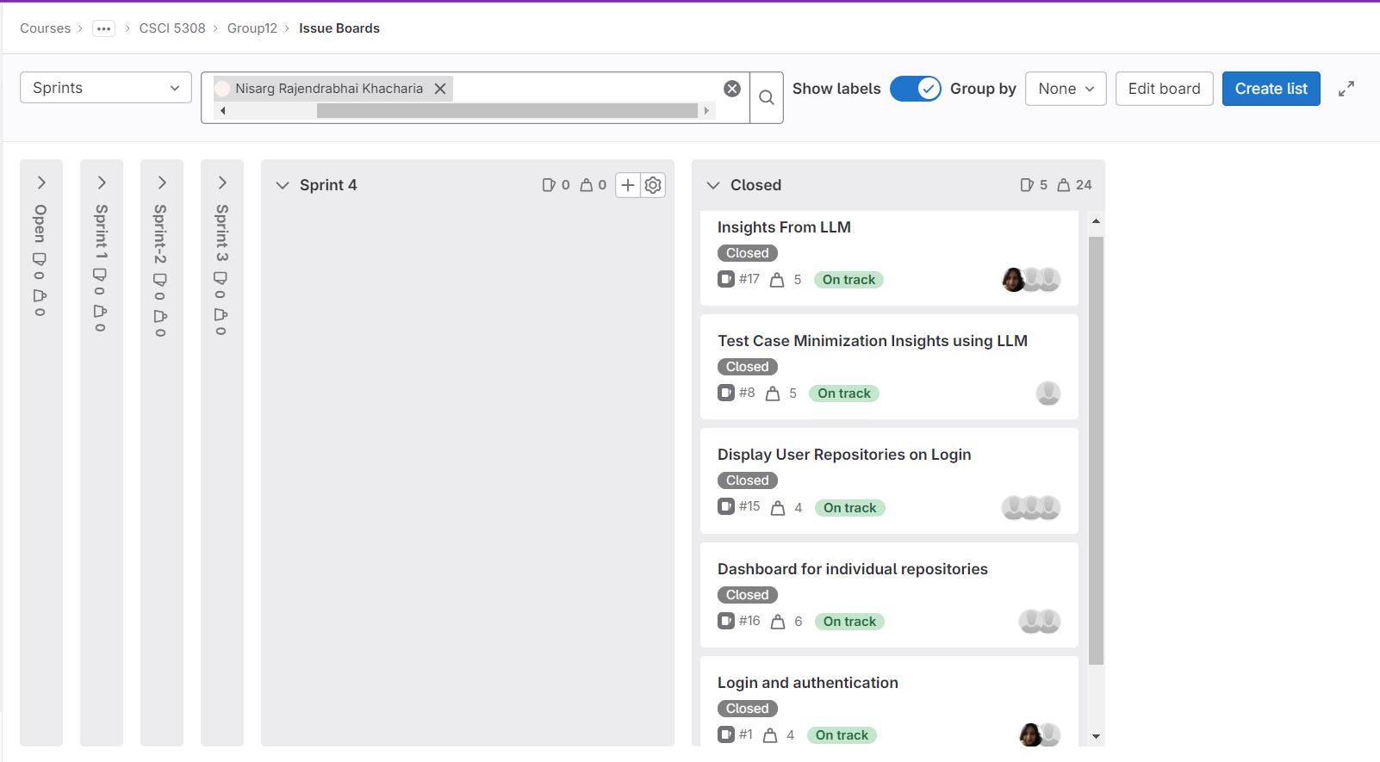
Nisarg’s Contribution

Slide 9
Nisarg’s Contribution
Task | Story | Points
UI for individual repositories | Dashboard for individual repositories | 1
Integration of repository data with dashboard | Dashboard for individual repositories | 1
UI for repository dashboard | Display User Repositories on Login | 1
Authentication using GitHub OAuth API | Login and authentication | 2
Feasibility Analysis | Test Case Minimization Insights using LLM | 1
Prompt Engineering | Test Case Minimization Insights using LLM | 1
Development and Integration | Test Case Minimization Insights using LLM | 3
Feasibility Analysis | Insights From LLM | 1

Slide 10
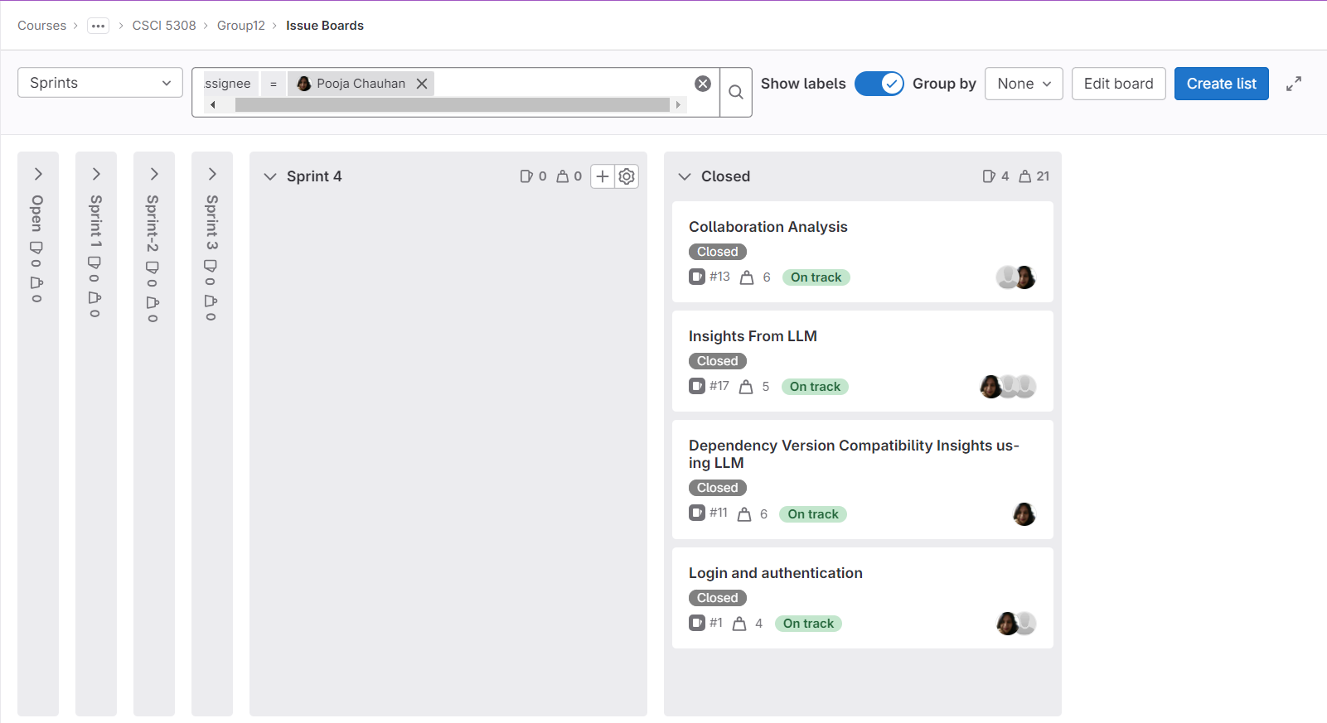
Pooja’s Contribution

Slide 11
Pooja’s Contribution
Task | Story | Points
UI for Login | Login and authentication | 1
Feasibility Analysis | Insights From LLM | 0.5
End-to-end integration with dynamic repo data | Insights From LLM | 0.5
Feasibility Analysis | Collaboration Analysis | 0.5
Prompt Engineering | Collaboration Analysis | 0.5
Development and Integration | Collaboration Analysis | 2
Add UI part for dependency Version | Dependency Version Compatibility Insights using LLM | 1
Retrieve pom.xml from the source code for filter artifactID and versions | Dependency Version Compatibility Insights using LLM | 2
check for pom.xml from Open PRs | Dependency Version Compatibility Insights using LLM | 2
Integrate and UI with the backend | Dependency Version Compatibility Insights using LLM | 1

Slide 12
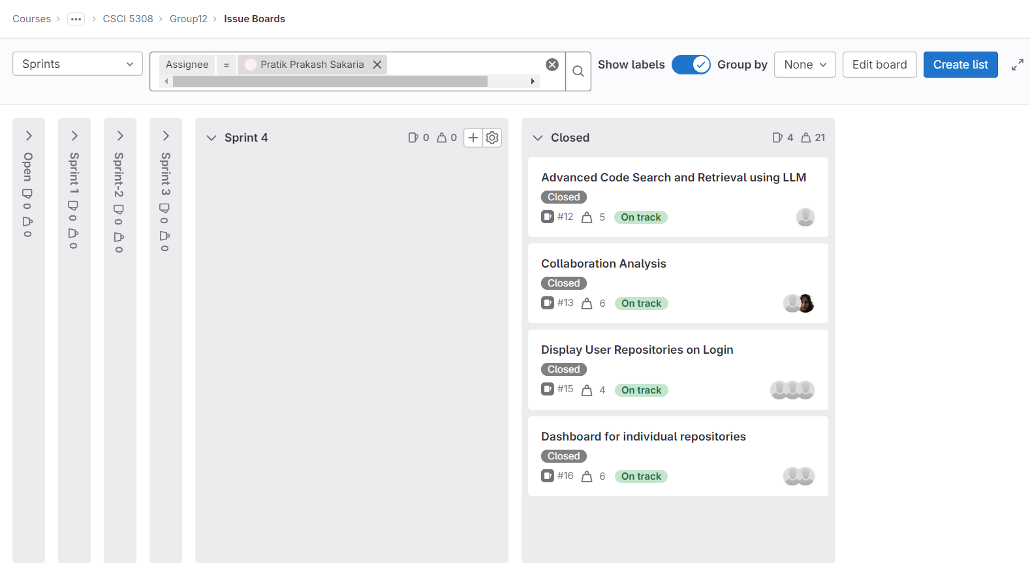
Pratik’s Contribution

Slide 13
Pratik’s Contribution
Task | Story | Points
Exploring GitHub APIs | Dashboard for individual repositories | 1
Provide repository data for the backend | Dashboard for individual repositories | 2
Integration of repository data with dashboard | Dashboard for individual repositories | 1
Feasibility Analysis | Collaboration Analysis | 0.5
Prompt Engineering | Collaboration Analysis | 0.5
Development and Integration | Collaboration Analysis | 2
Feasibility Analysis | Advanced Code Search and Retrieval using LLM | 1
Prompt Engineering | Advanced Code Search and Retrieval using LLM | 1
Development and Integration | Advanced Code Search and Retrieval using LLM | 3
API development for fetching repository list from GitHub API | Display User Repositories on Login | 1

Slide 14
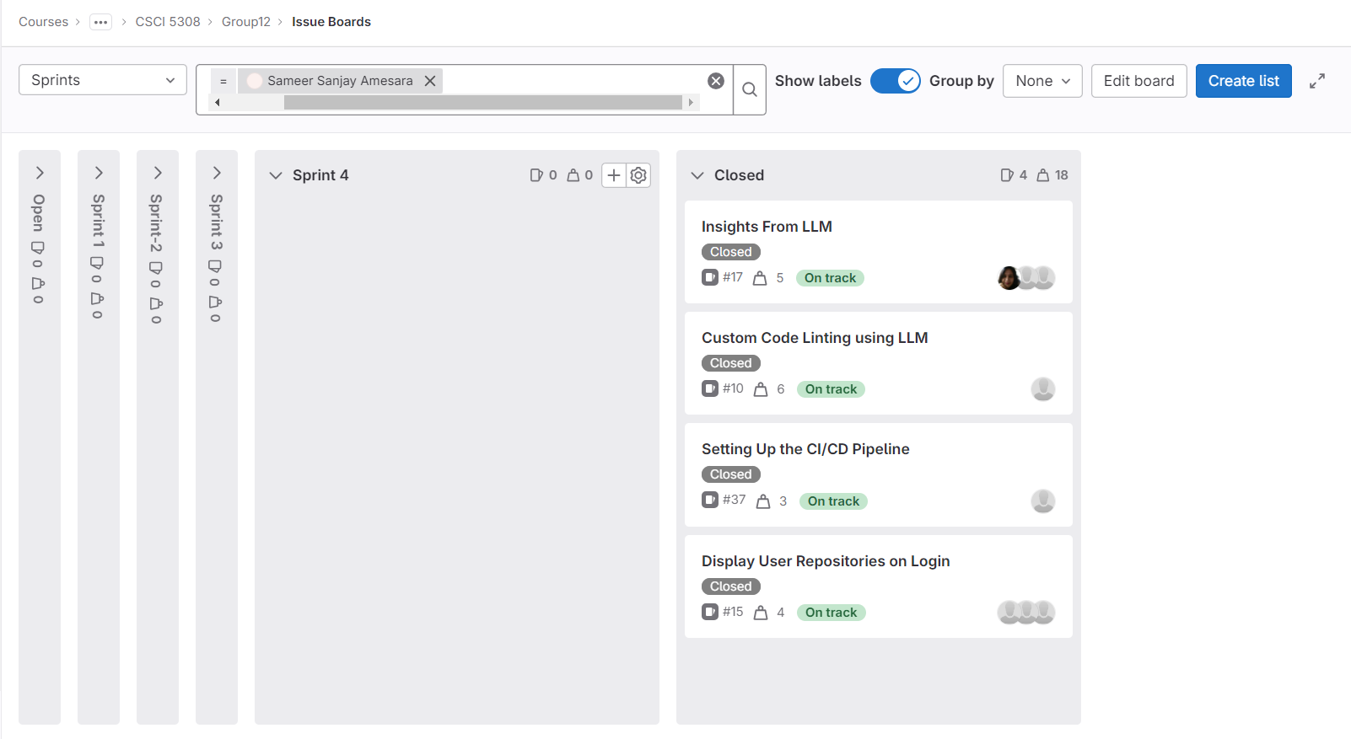
Sameer’s Contribution

Slide 15
Sameer’s Contribution
Task | Story | Points
Feasibility Analysis | Custom Code Linting using LLM | 1
Prompt Engineering | Custom Code Linting using LLM | 2
Development and Integration | Custom Code Linting using LLM | 3
LLM Insights Wireframe Development | Insights From LLM | 2
Developing Tests for the Application | Insights From LLM | 1
Publishing the application on the docker hub | Setting Up the CI/CD Pipeline | 1
Deploying on server | Setting Up the CI/CD Pipeline | 1
Building the pipeline | Setting Up the CI/CD Pipeline | 1
Integrating data with UI dashboard | Display User Repositories on Login | 2

Slide 16
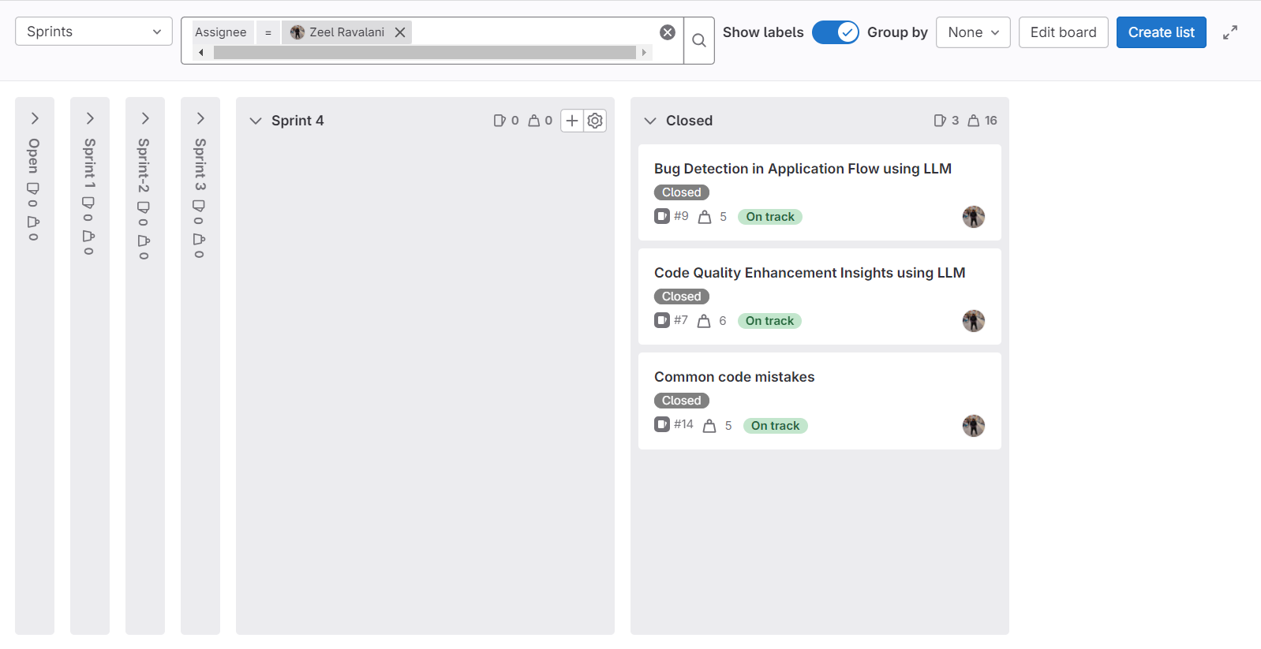
Zeel’s Contribution

Slide 17
Zeel’s Contribution
Task | Story | Points
Feasibility Analysis | Common code mistakes | 1
Prompt Engineering | Common code mistakes | 1
Development and Integration | Common code mistakes | 3
Feasibility Analysis | Code Quality Enhancement Insights using LLM | 1
Prompt Engineering | Code Quality Enhancement Insights using LLM | 1
Development and Integration | Code Quality Enhancement Insights using LLM | 2
Feasibility Analysis | Bug Detection in Application Flow using LLM | 1
Prompt Engineering | Bug Detection in Application Flow using LLM | 1
Development and Integration | Bug Detection in Application Flow using LLM | 3

Slide 18
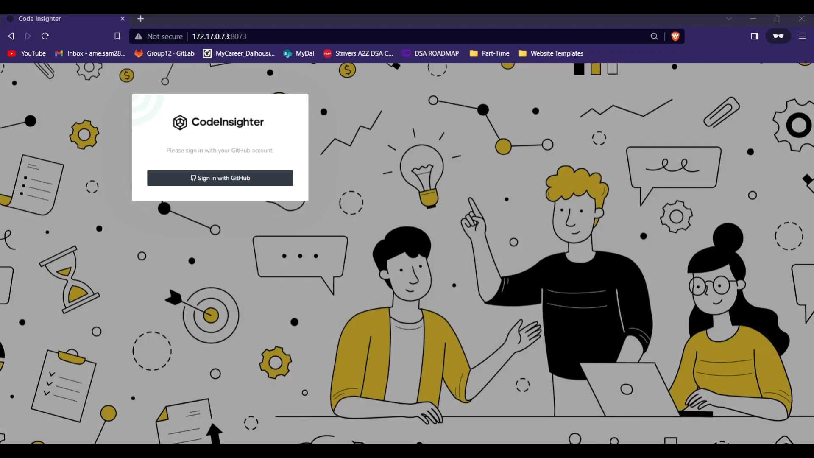
Project Demo Video

Slide 19
Project Status
Our Goals | Status
Use coding practices | The team used Javadoc styling in the code as well as writing comments to make it more readable.
Implement CI/CD pipeline | We did this and made sure our builds were clean every time.
Implement insights recommended by client team | We implemented all that were flagged important by client team
Integrate and test entire functionality together | We did this successfully.
Complete all user stories | We initially had some stories in the backfoot but at the end of the day we pulled it off by doing everything.
GitLab board maintenance | Ours wasn’t up to the mark in the starting but we managed to fix it after being flagged
Attend all meetings with client and TA | We did manage to meet every time and if any member wasn’t able to attend, we proactively informed the TA of our status.

Slide 20
Learnings
Never take a Professor's project - We are kidding, we'll clear engineering requirements on the project's first date by involving the client team and TA more and stick to our roadmap if we get a lifeline again!
Proactive Communication - Acknowledge the dinosaur in the room early on and ensure everyone is on the same page at each stage.
Time management - While hitting deadlines has become our signature move, we've realized that we shouldn’t head into rush hour chaos but have a more organized time management approach.
Proactive Support and Team Harmony - We wouldn’t have a lone wolf approach at any cost if given a second chance!

Slide 21
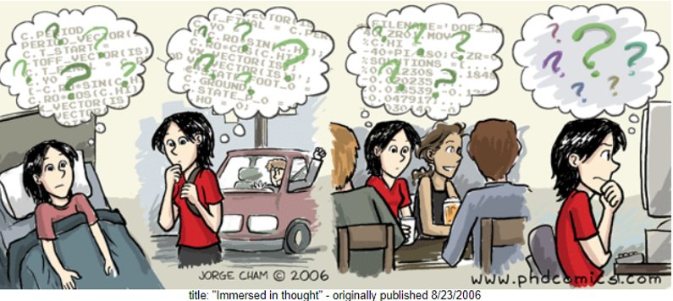
Questions?

